Slide 1
Single cell genomics!
GNOM 540
Tuesday, March 6, 2018

Slide 2
Why single cell?
Bulk
Measures average gene expression levels across a population of cells
Useful for quantifying gene expression in homogeneous populations
Cheaper, easier, and more straightforward to analyze
Single cell
Measures the distribution of gene expression levels across a population of cells
Useful for studying cell-specific transcriptomic differences in heterogeneous populations
More difficult to collect and analyze, but allows us to study new questions

Slide 3
Applications of single-cell RNA-seq
Identifying rare cell subtypes
Mahata et al. (2014)
Shalek et al. (2014)
“If you compare the brain to a fruit salad, you could say that previous methods were like running the fruit through a blender and seeing what colour juice you got from different parts of the brain…[Single-cell RNA-seq] is like taking pieces of the fruit salad, examining them one by one and then sorting them into piles to see how many different kinds of fruit it contains, what they’re made up of and how they interrelate.” – Sten Linnarsson
Sandberg, R. (2013). Entering the era of single-cell transcriptomics in biology and medicine. Nat. Methods 11, 22-24.
Notes:
Mahata et al. (2014): identify subpopulation of Th2 cells that produce the steroid pregnenolone → suppresses T-cell proliferation, and thus helps maintain homeostasis
Shalek et al. (2014): identify bone marrow DCs that are early responders to LPS induced inflammatory signals

Slide 4
Applications of single-cell RNA-seq
Identifying rare cell subtypes
Mahata et al. (2014)
Shalek et al. (2014)
Trace lineage/developmental relationships between cell states
Treutlein et al. (2014)
Cao et al. (2017)
Measure stochasticity of gene expression
Meredith et al. (2015)
Sandberg, R. (2013). Entering the era of single-cell transcriptomics in biology and medicine. Nat. Methods 11, 22-24.
Notes:
Treutlein et al. (2014): reconstructed lineage hierarchies of distal lung epithelium from single cell data
Cao et al. (2014): single cell data from whole worm → resolves to separate tissues and cell types; different neuron types were resolved, even down to neurons with copy number of 1-2

Slide 5
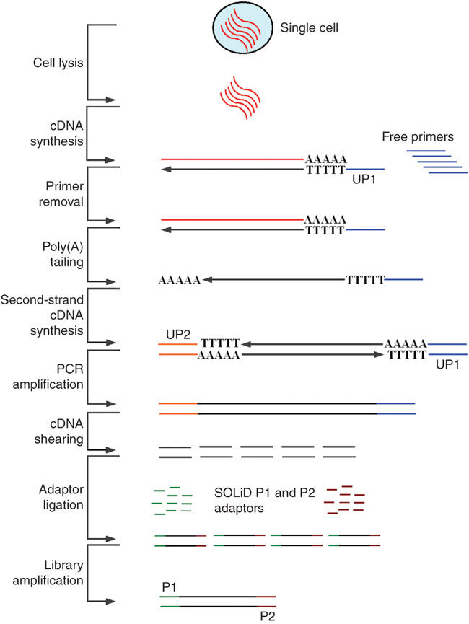
Brief history of single cell RNA-seq
2009: Tang et al. collect RNA-seq data from manually isolated single mouse blastomeres
2012: Hashimshony et al. CEL-seq incorporates multiplexed linear amplification to increase sensitivity
2012: Fluidigm C1 introduces a commercial platform for single cell RNA-seq
2014: Jaitin et al. use FACS and automated processing to increase throughput and reproducibility
2015: Klein et al. (inDrop) and Macosko et al. (Drop-seq) isolate single cells in droplets
2016: 10x Chromium platform for droplet-based single-cell RNA-seq
2017: Cao et al. (sciRNA-seq) combinatorial indexing to virtually compartmentalize single cells
Tang et al. (2009)
Notes:
Tang et al. blastomeres were from the 4-cell stage
Fluidigm: integrated fluidic circuit to capture cells

Slide 6
Typical single cell experimental workflow

Slide 7
How are single cells isolated?
Gross et al. (2015). Technologies for Single-Cell Isolation. Int. J. Mol. Sci. 16(8) 16897-919.
Notes:
LCM: laser capture microdissection

Slide 8
How are single cells isolated?
Cao et al. (2017). Comprehensive single-cell transcriptional profiling of a multicellular organism. Science 357(6352) 661-67.
Notes:
LCM: laser capture microdissection

Slide 9
How are single cells isolated?
Klein et al. (2015). Droplet Barcoding for Single-Cell Transcriptomics Applied to Embryonic Stem Cells. Cell 161(5) 1187-201.
Notes:
LCM: laser capture microdissection

Slide 10
How are single cells isolated?
10x Genomics, https://www.10xgenomics.com/solutions/single-cell/
Notes:
LCM: laser capture microdissection

Slide 11
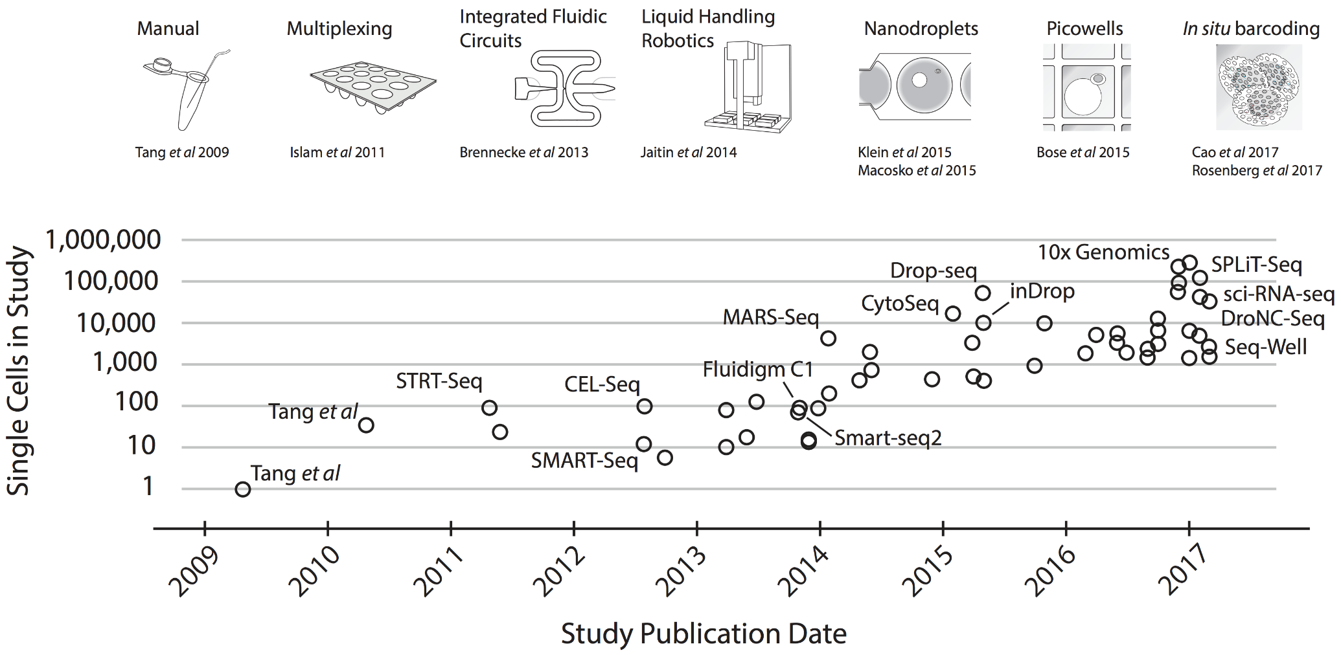
Evolution of single cell methodologies
Svensson et al. (2017). Exponential scaling of single-cell RNA-seq in the last decade. arXiv:1704.01379v2

Slide 12
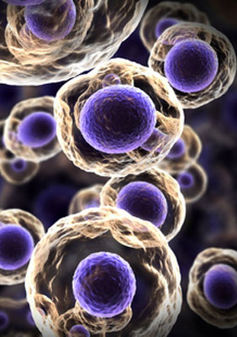
Which platform to use?
Input requirements
Minimum number of cells needed?
Cell conditions (fresh vs. fixed)?
Experimental design
Number of samples to collect?
Number of cells needed per sample?
Controlling for batch effects?
Cost/availability

Slide 13
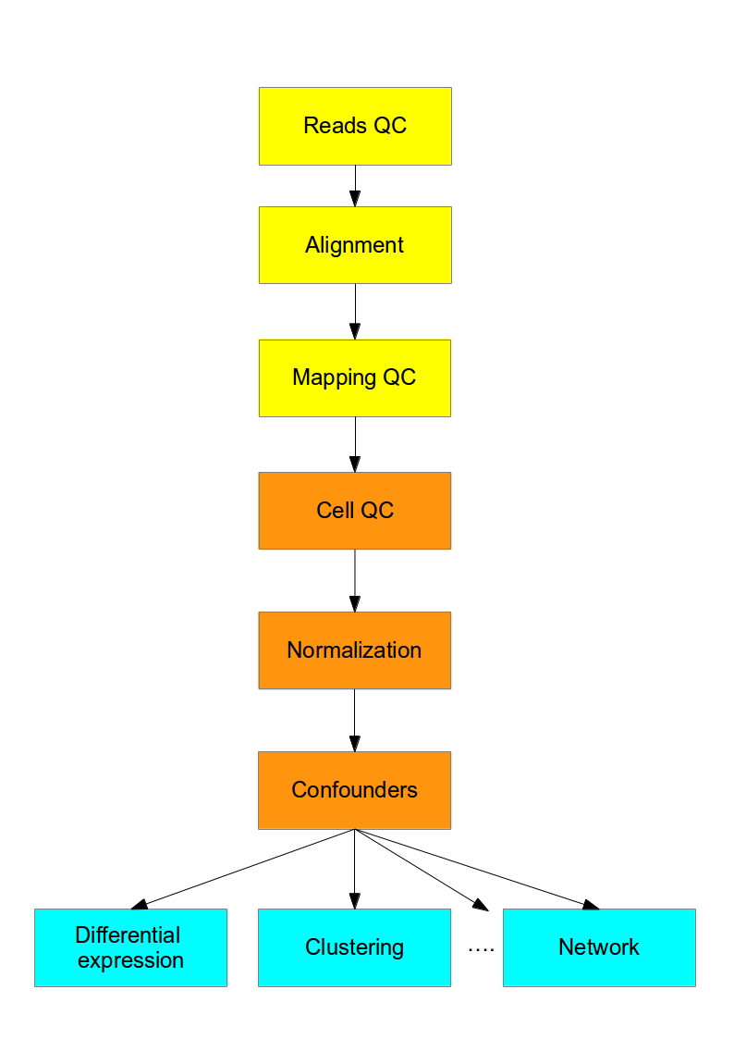
Computational workflow
~400K mRNA transcripts in a mammalian cell → 500k-5M reads per cell
Typically sequence up to 80-90% duplication
Quantitative controls
ERCC spike-ins (92 synthetic spikes, based on bacterial sequences)
Unique Molecular Identifiers (UMIs)
Stegle et al. (2015)

Slide 14
Computational workflow
Read quality, alignment, mapping → can use the same metrics as for bulk RNA-seq data
Cell quality → want to filter out cells with degraded RNA, doublets, “cells” of free-floating RNA
Normalization of read counts
FPKM implicitly assumes similar total amount of RNA processed per sample
ERCC and/or UMI-based normalization
Stegle et al. (2015)

Slide 15
Challenges of single-cell data
Gene dropout
mRNA capture rate ~65%
Zero-inflated distributions
Confounding effects (cell cycle, apoptosis, etc.)
Latent-variable models to correct for confounding variation
High variability
Distinguishing between biological and technical variation
Stegle et al. (2015). Computational and analytical challenges in single cell transcriptomics. Nat. Rev. Genetics 16, 133-45.

Slide 16
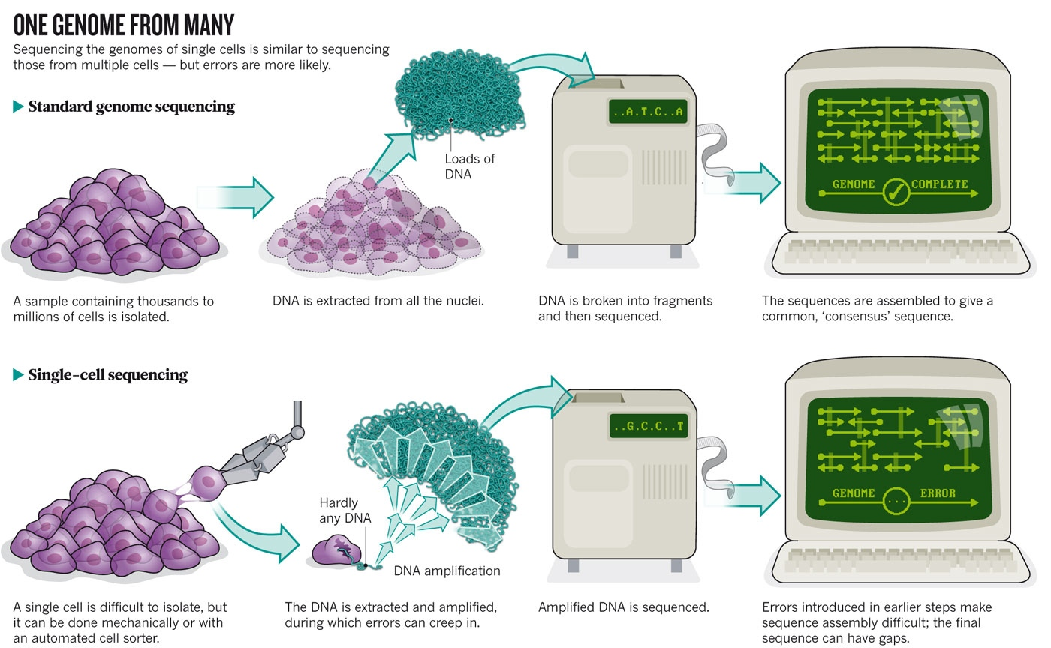
Owens, Brian. (2012). Genomics: The single life. Nature 491, 27-29.

Slide 17
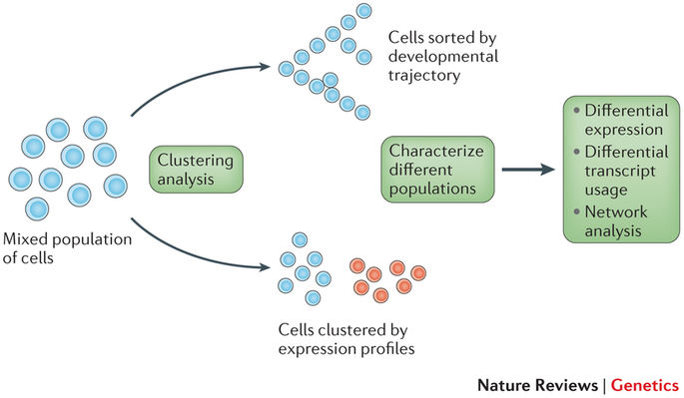
Downstream analysis
Stegle et al. (2015). Computational and analytical challenges in single cell transcriptomics. Nat. Rev. Genetics 16, 133-45.
Notes:
This is where biological interpretations/new insights come in!
Both clustering and trajectory analyses will typically be combined with a dimensionality reduction technique
Combine prior biological knowledge (e.g. markers for cell types) with the patterns observed in the groupings of single cells to draw new inferences

Slide 18
Resources
Analysis of single cell RNA-seq data (Cambridge University, Hemberg Lab)
awesome-single-cell github (list of software resources)
A practical guide to single-cell RNA-sequencing for biomedical research and clinical applications (Haque et al. 2017)
MCB112: Biological Data Analysis, Lecture 06 (Harvard)
simpleSingleCell (step-by-step workflow for low-level analysis of single-cell RNA-seq data with Bioconductor)

